Slide 1

Modern foreign languages: policy and funding context
Chris Millward
Reshaping Languages in Higher Education Conference
10 July 2014
Notes:
Introduction to talk…

Slide 2
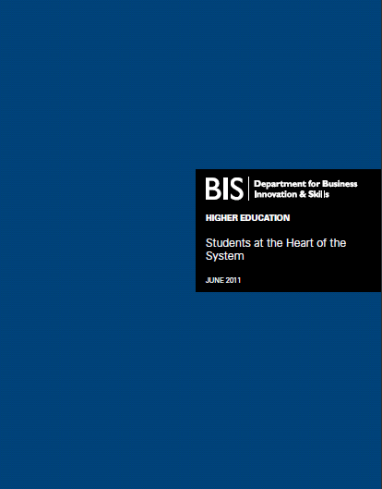

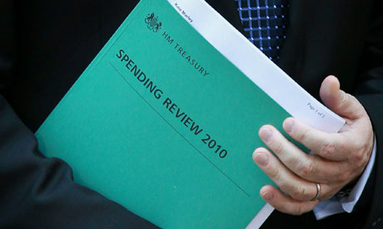
2010-15 – a new settlement

Slide 3
Breakdown of real terms teaching income to HEIs 2009-10 to 2015-16
Notes:
Source: Data based on institutional financial forecasts and includes actual income for the period up to and including 2011-12, and forecast income for 2012-13 to 2014-15. *‘Other fee income’ includes part-time fee income (Home and EU), full-time postgraduate fee income (Home and EU) and other fees and support grants.

Slide 4
HEFCE’s role 2010-2015
Public interest funding:
  high cost subjects, institutions and activities; supporting change
Assurance:
    quality, information, financial sustainability
Monitoring and evidence:
  students, subjects, places
Whole institution and system:
  teaching, research and knowledge exchange
Notes:
Frame broadly in terms of wider HE (ie what’s happening at bigger level, the HE reforms):
Where we are now
Changing role of HEFCE
Relationship HEFCE/BIS (ie broader BIS agenda)
Where we might be after General election in May 2015

Slide 5
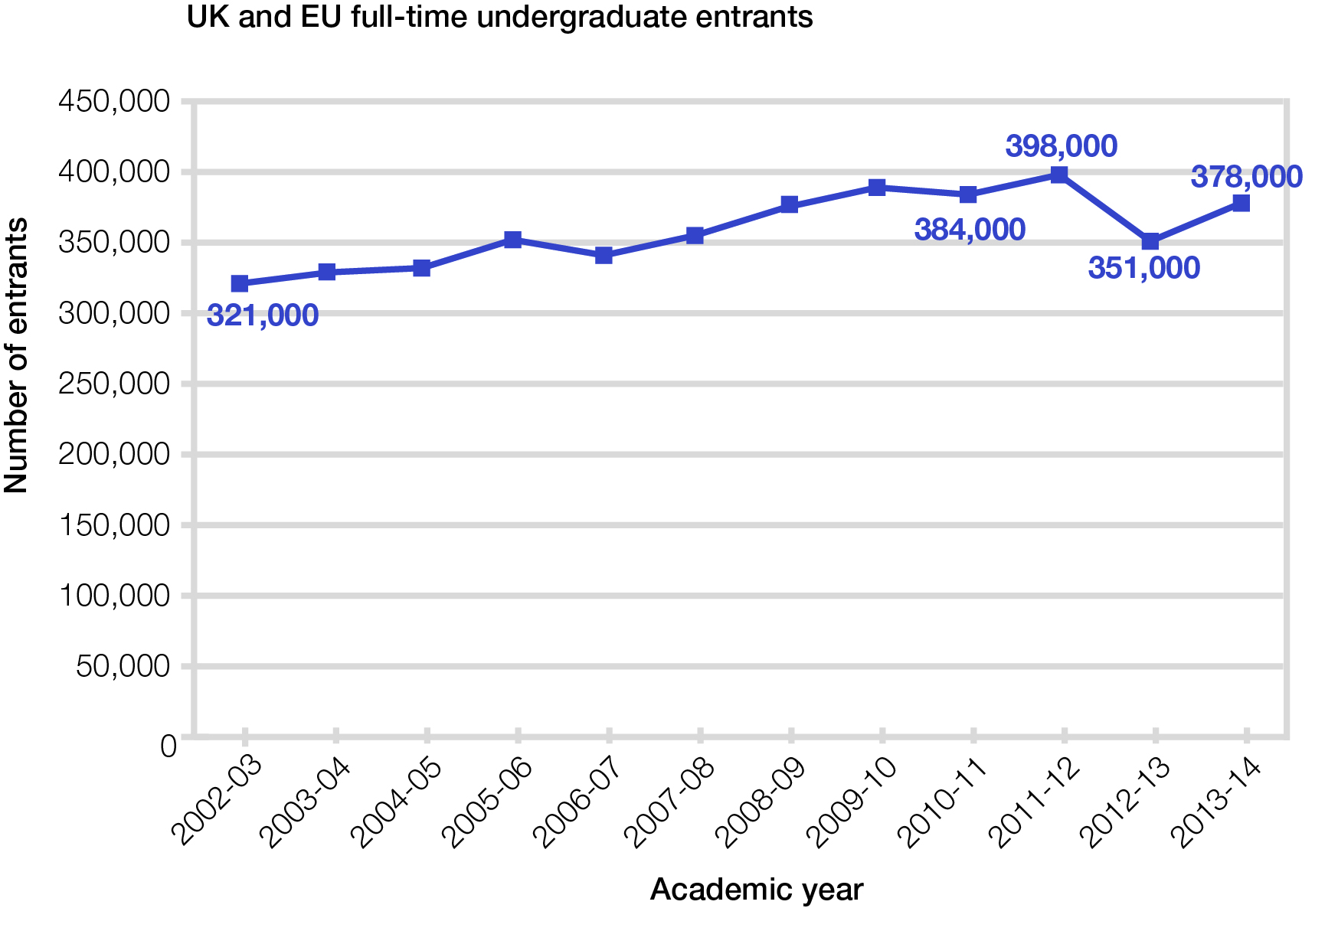
UG home and EU full-time entrants
Notes:
Speaking notes:
This gives the context – key developments in HE in the last year or so
Could also refer to ‘Uncertainties’ here (or in policy themes slide)
legislation
student number controls from 2013-14
student demand (undergraduate, postgraduate and overseas)
new providers
Also set out ‘structure’ of presentation:
Background – developments and themes in HE
Financial health of the sector
HEFCE’s grant letter and funding for 2012-13
HEFCE funding for specific areas – teaching, research, KE, capital and special funding
Drafting notes:
Change pic?
Docs shown are
BIS: Innovation and research strategy for growth
A new fit for purpose regulatory framework for the higher education sector
Students at the heart of the system

Slide 6
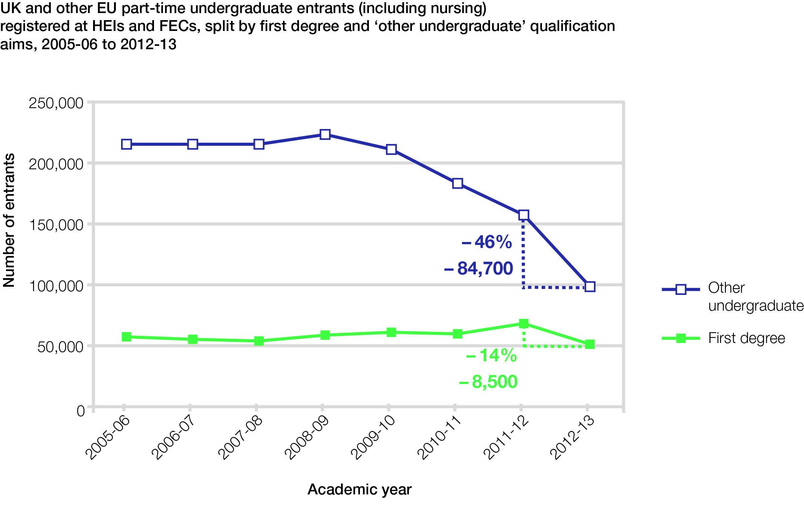
UG home and EU part-time entrants (2)
Notes:
Speaking notes:
This gives the context – key developments in HE in the last year or so
Could also refer to ‘Uncertainties’ here (or in policy themes slide)
legislation
student number controls from 2013-14
student demand (undergraduate, postgraduate and overseas)
new providers
Also set out ‘structure’ of presentation:
Background – developments and themes in HE
Financial health of the sector
HEFCE’s grant letter and funding for 2012-13
HEFCE funding for specific areas – teaching, research, KE, capital and special funding
Drafting notes:
Change pic?
Docs shown are
BIS: Innovation and research strategy for growth
A new fit for purpose regulatory framework for the higher education sector
Students at the heart of the system

Slide 7
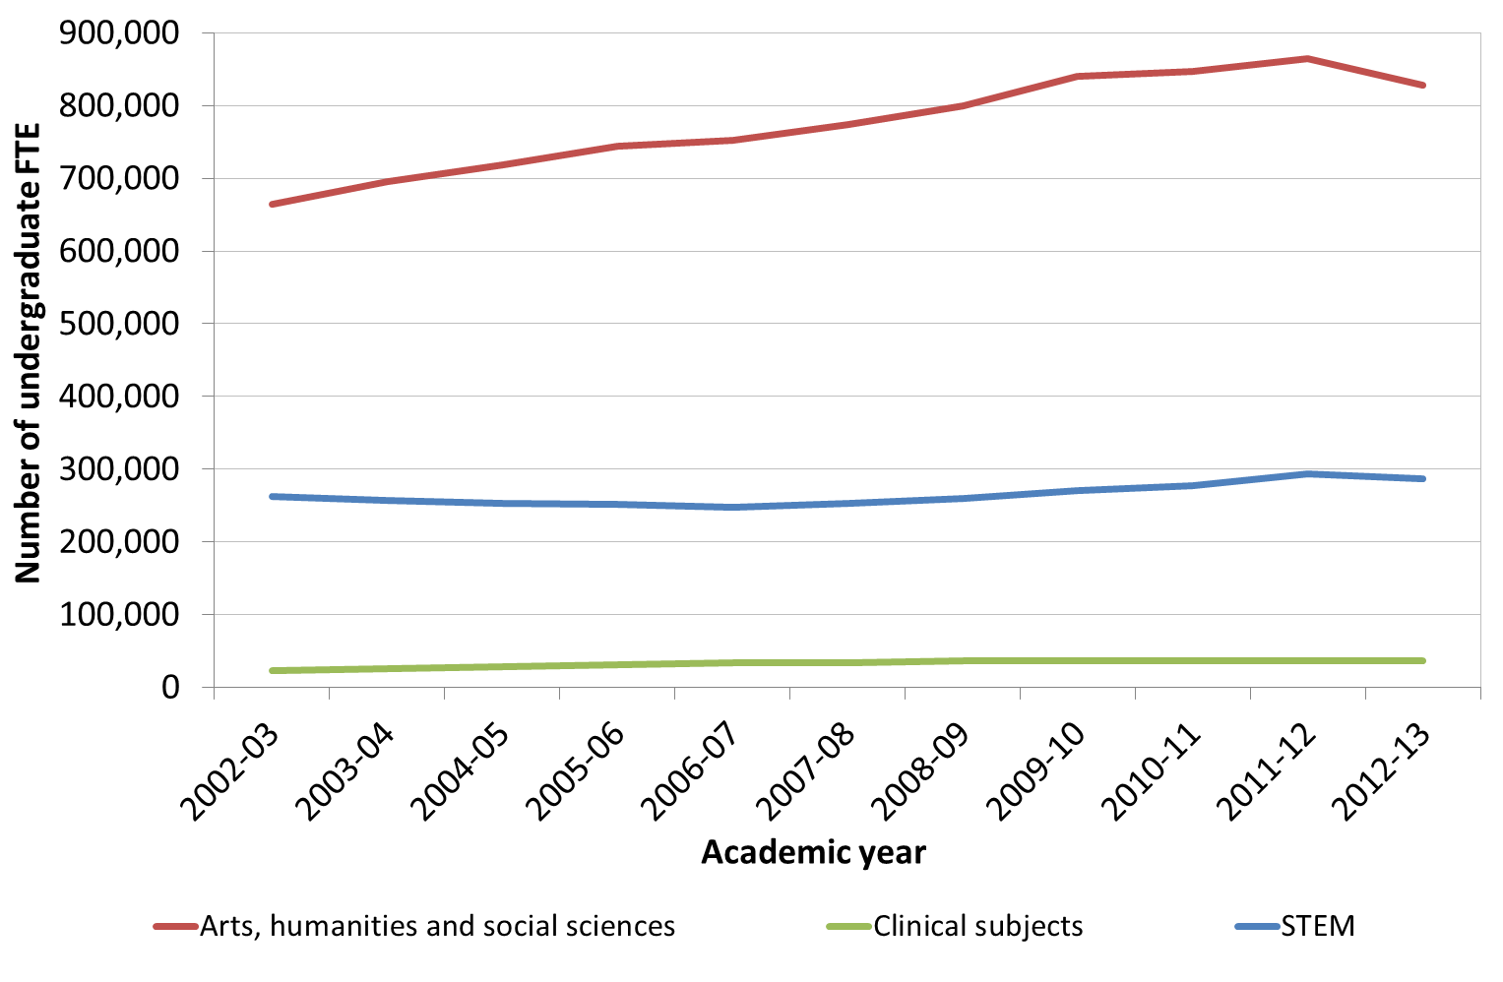
*HESA – all years and domiciles
Undergraduate students

Slide 8
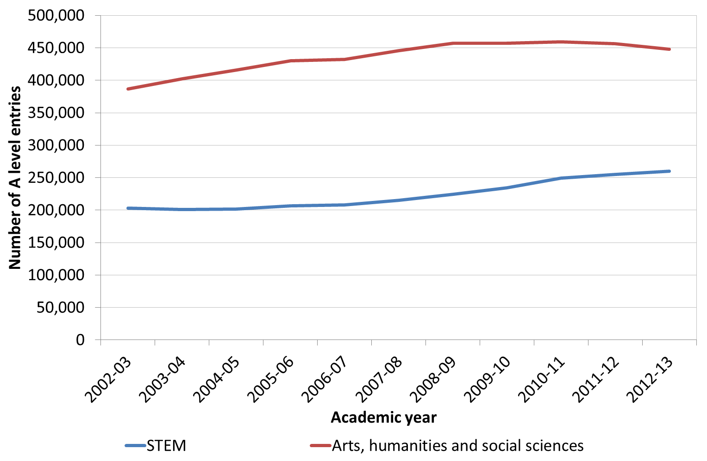
A-Level entries

Slide 9
HEFCE’s role 2010-2015: MFL
Public interest funding:
  Year abroad
  Routes into Languages
  Supporting innovation and change (?)
Monitoring and evidence:
  HE in England ‘impact report’
Notes:
Frame broadly in terms of wider HE (ie what’s happening at bigger level, the HE reforms):
Where we are now
Changing role of HEFCE
Relationship HEFCE/BIS (ie broader BIS agenda)
Where we might be after General election in May 2015

Slide 10
Number of A level entries
Source: DfE publications A level 2013-13, revised January 2014
Notes:
Latest data illustrates a general fall in number students taking ‘A’ level (though slight recovery 2005-6 to 2009-10, driven by a slight increase in Spanish and other languages)
Particular impact on French – by far the dominant MFL in 1990s, dropped 20% since 2005
German continuing headache: much smaller numbers flattering out 2005-06 to 09-10, but since then dropped to MFL with lowest number of ‘A’ level entries
Other concern (not illustrated) = decrease in number of students undertaking a second ‘A’ level in a foreign language– essential for some careers including Translation/Interpreting

Slide 11
Number of UCAS acceptances
Notes:
Increase EU 2008-9 to 2011-12, following which both EU/non EU have decline, with non-EU steeper decline from a smaller pool of students (- 14% decline post-HE funding changes in 2012)
Saw decline in several subjects post HE funding changes - most are bouncing back, but not MFL)

Slide 12
Mode of study (full or part-time)
Notes:
EU - FT population maintained broadly flat until 2011-12 then decline
Non-EU: FT relatively flat, (884 students) PT has fallen to concerning low level (566 students) with suspected longer-term decline for PT

Slide 13
Type (single or joint honours)
Notes:
From 2011-12 sharp decline in MFL single honours (more so than with other subjects)
MFL single hons still most popular mode of modern language study but can see gap is closing

Slide 14
Diversity (POLAR3 data)
Notes:
MFL dominated by entrants from highest-participation wards (5) (almost double as many than the next highest (4) and five times more than the lowest participation ward (1) – although 2012-13 has seen a slight (1%) increase (the Routes effect??)

Slide 15
Increasing MFL study outside degree programme
Reported numbers as compared to 2012:
Most reported increases compared with 2012:
Source: UCML-AULC survey of Institution-wide Language Provision in universities in the UK (2012-2013)
Notes:
Most recent UCML-AULC survey of Institution-wide Language Provision in universities in the UK (2012-13)
indicates evidence of growth in university non-specialist language study through language centres and institution-wide language programmes. These typically comprise elective language course units taken for academic credit and language courses studied in addition to/alongside a student’s degree programme. These courses are not a compulsory component of the degree programme for which they are registered.
Chart 1: half of responding institutions reported an increase in numbers, and in some institutions the increases were highly significant. Suggests recruitment onto IWLP courses generally appears to be buoyant, unlike the languages sector in HE as a whole.
Chart 2: Study indicated a positive picture of student recruitment onto IWLP courses, with continued growth in non-European languages, particularly Chinese and Arabic. Also interesting growth in German, particularly struggling at degree level recruitment.
But
All subject areas fairly consistent since 2009-10, showing slight increase
Assuming accredited study of module MFL outside other area of study, is worth 20 credits:
Does one module give sufficient skills for proficient, in-depth MFL skills, and enough language and cultural learning to meet the national capacity?
Is 2.4% of the student population sufficient (of over 300,000 students!)
http://www.heacademy.ac.uk/assets/documents/disciplines/Languages/UCML_AULC_Survey_of_Institution_Wide_Language_Provision.pdf

Slide 16
Short-term issues
    2014-15
    -5.85% HEFCE teaching grant
    +30k student numbers, recognising previous growth
    +£25m HEFCE Postgraduate Support Scheme
    2015-16
    Removal of the cap on student numbers
    +£50m for taught postgraduate education and government review
    REF outcomes

Slide 17

Medium and longer-term issues
    DfE and BIS
    Fee levels and re-payment terms
    Teaching grant and student numbers
    Regulatory landscape

Slide 18

Thank you for listening
c.millward@hefce.ac.uk

